Slide 1
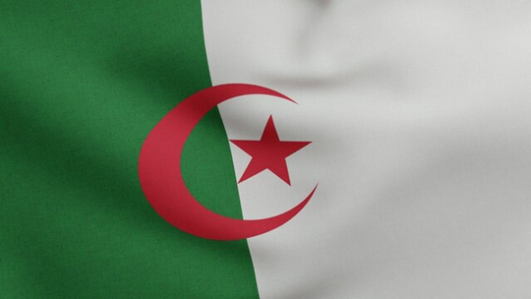
MINISTRY OF FOREIGN AFFAIRS EMBASSY OF GREECE IN ALGIERS OFFICE FOR ECONOMIC & COMMERCIAL AFFAIRS
Exploring ways for deepening bilateral economic co-operation on a win-win basis

Slide 2
ESSENTIALS
A Southern Mediterranean market with a population of approximately 47 million, Algeria
moved to the upper-middle income category under the World Bank’s country income classification last July
People's Democratic Republic of Algeria
ON THE CROSSROADS OF THREE WORLDS: MEDITERRANEAN, ARAB, AFRICAN
BLESSED WITH ABUNDANT NATURAL RESOURCES INCLUDING PETROLEUM, NATURAL GAS, IRON ORE, PHOSPHATES, URANIUM, LEAD AND ZINC
AMONG OTHERS.
WITH ITS LARGE RESERVES, ALGERIA FIGURES AMONG THE LEADING HYDROCARBON PRODUCERS AND EXPORTERS WORLDWIDE.
Algeria’s economy is largely driven by the oil and gas sector. This sector contributes significantly to the country’s GDP and foreign exchange earnings.

Slide 3
OIL & GAS ARE HISTORICALLY CENTRAL TO ALGERIA’S GROWTH & SUCCESS
AT THE SAME TIME , this high dependency on hydrocarbon revenues constitutes a major challenge to be addressed
the government strives after diversifying the economy. To this end, Algeria endeavours, among other things,
to attract investors in promising sectors
to encourage local production, considering the reduction of imports as stimulating factor

Slide 4
BILATERAL TRADE
Main Algerian exports to Greece:
Liquefied natural gas, petroleum oils, propane, anhydrous ammonia, bars and rods of iron/steel
Main Greek exports to Algeria:
Petroleum bitumen, lubricants, fertilizers, marble, motor oils, cotton, tobacco

Slide 5
KEY SECTORS IDENTIFIED AS HAVING HIGH GROWTH POTENTIAL AND PRIORITIZED FOR DEVELOPMENT IN ALGERIA
AGRICULTURE
RENEWABLE ENERGY (SOLAR)
INFRASTRUCTURES
(useful tender announcement websites: arches-publics.gov.dz, bomop.anez.dz, baosem.com, algeriatenders.com, dztenders.com, tenders-dz.com, algeriemarches.com etc)
MANUFACTURING
ICT
TOURISM

Slide 6
Doing business in Algeria offers a mix of challenges and opportunities
Choose the right partners and build strong local partnerships
Acquire a deep understanding of the local context
Come and visit/participate to the international trade fairs in Algeria
Conduct a thorough market research and have a clear perception of the regulatory landscape
Be sensitive and respectful to religious and cultural issues
Use your southern mentality to understand the Algerian environment. Be adaptable and patient
First entry contact / promotional sales material and documentation in Arabic and in French

Slide 7
THE OFFICE FOR ECONOMIC & COMMERCIAL AFFAIRS OF THE EMBASSY OF GREECE IN ALGIERS
ecocom-alger@mfa.gr
tel. +213 23 37 79 84
60, Avenue Bougara, El Biar, Algiers
THANK YOU

