Slide 1
SOUTH AFRICA: REPLETE WITH OPPORTUNITIES

Slide 2
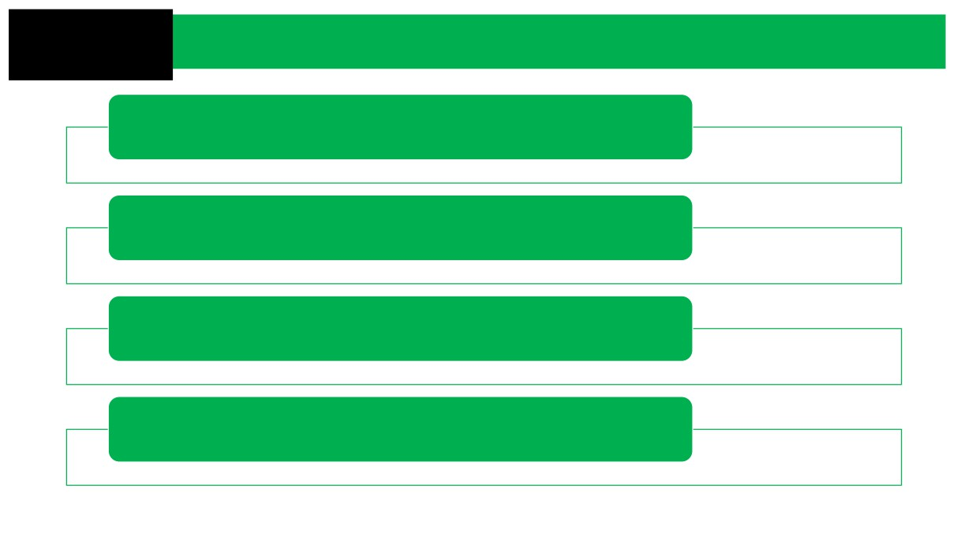
Content
South Africa at a Glance
Priority Sectors
Provincial Sector Overview
Resources

Slide 3
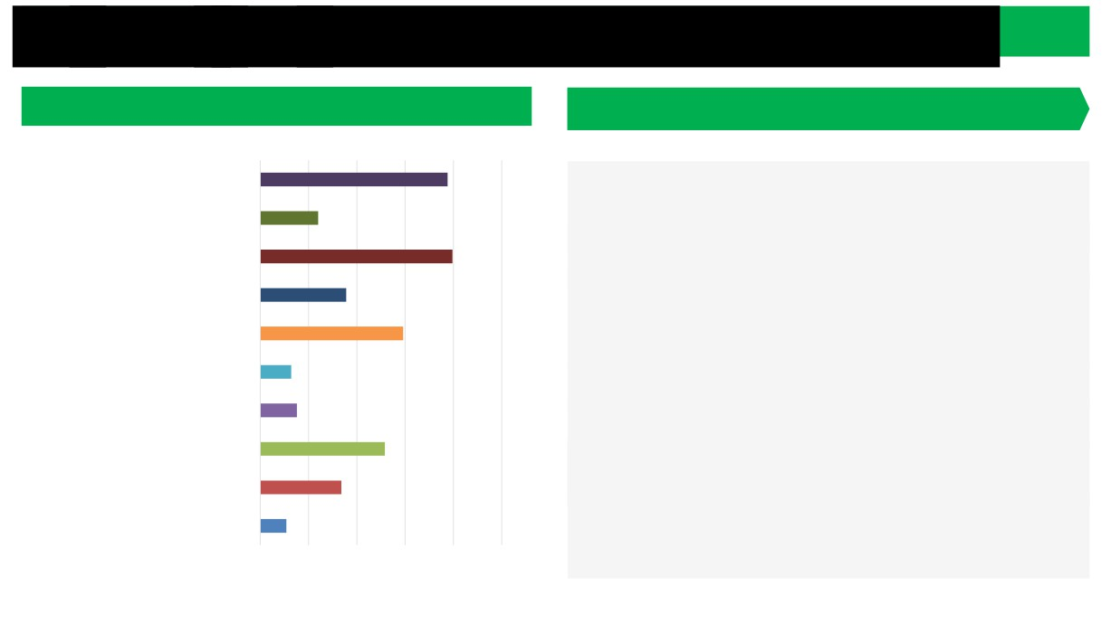
Th Economy South African economy offers a strong value proposition
Sectoral composition of South Africa’s gross domestic product (GDP)
South Africa’s value proposition
General Government 19.4%
o Africa’s most industrialised economy. It is the region’s principal
Community, Social & Personal Services 6.0%
manufacturing hub and a leading services destination.
Finance, Insurance, Real Estate &
o Highly diversified economic structure in terms of sectoral
Business Services
19.9%
composition.
Transport, Storage & Communication
8.9%
o One of the most open economies in the world (ratio of exports and
Wholesale & Retail, Trade, Catering & Accommodation
imports to GDP exceeds 58%). Preferential access to numerous global markets.
14.8%
Construction
3.2%
o Endowed with an abundance of natural resources.
Electricity, Gas & Water
3.8%
o An extensive and modern infrastructure network.
Manufacturing
12.9%
o Sophisticated banking sector with a major footprint in Africa. It is
Mining & Quarrying
8.4%
the continent’s financial hub.
Agriculture, Forestry & Fisheries
2.7%
o Offers a supportive and growing ecosystem as a hub for innovation, technology and fintech.
0.0%
5.0% 10.0% 15.0% 20.0% 25.0%
3
South African Embassy, Athens

Slide 4
South Africa at a Glance
(as at June 2023)
ZAR 7,688,65 trillion
60.6 million (majority <35 yrs)
(US$ 419 billion)
Exports - US$ 130 billion
1 219 090 km2 (79.4% agricultural)
3 International Airport
Inflation - 5.4%
8 Seaports
REPO Rate - 8,25% PRIME Rate - 11.75%
US$ 1.00 - ZAR 18.35

Slide 5
Sector Focus
Green Economy
• Green energy
• Recycling
• Hydrogen
• Biofuels
• Water infrastructure
• Co-generation
Resource Based Industries
• Mining
• Agro-processing
• Aquaculture
• Agriculture
• Mineral beneficiation
• Ocean / blue economy
Services Industries
• Oil & gas
• Ship building
• Ship repairs
• Business process outsourcing
• Films
• Explorations

Slide 6
Sector Focus
Manufacturing
• Automotive
• Leather & footwear
• Clothing & textiles
• Rail
• Metals fabrication
• Yellow goods
• Heavy vehicles
• Cosmetics
• FMCG
Advanced Manufacturing
• Plastics
• Electronics
• White goods
• Aerospace
• Pharma
• Chemicals
• Biochemical
• Defence industries

Slide 7
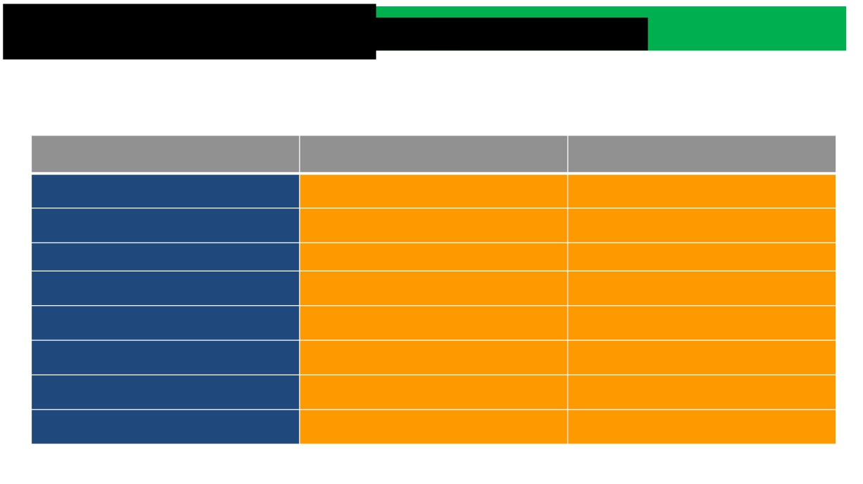
Platform to support growth: Preferentia access to key world markets
• South Africa is a member of the World Trade Organisation.
• Access to global markets has been enhanced through bilateral agreements with most of South Africa’s major trading partners. Preferential access to key export markets has been secured through various agreements and by participating in regional economic communities.
Agreement name
Type of agreement
Countries / regional blocs involved
South Africa, Botswana, Lesotho, Namibia, eSwatini (formerly Swaziland)
Southern African Customs Union (SACU) Customs union
Southern African Development Community (SADC) Free Trade Area
Free trade agreement
15 SADC member states
Economic Partnership Agreements
Free trade agreement
SACU- EU EPA plus Mozambique and Angola
SACU + EFTA (Iceland, Liechtenstein, Norway and Switzerland)
EFTA-SACU FTA
Free trade agreement
Unilateral assistance measures (non- reciprocal)
African Growth & Opportunity Act (AGOA)
US- 39 sub-Saharan African countries
Unilateral (non-reciprocal) Preferential trade agreement
SA- EU, Norway, Switzerland, Russia, Turkey, the US, Canada, Japan
Generalised System of Preferences (GSP)
SACU and Argentina, Brazil, Paraguay and Uruguay
SACU-Mercosur
Africa Continental Free Trade Area (AfCFTA)
Free trade agreement
AU member states
7
Source: Invest SA

Slide 8
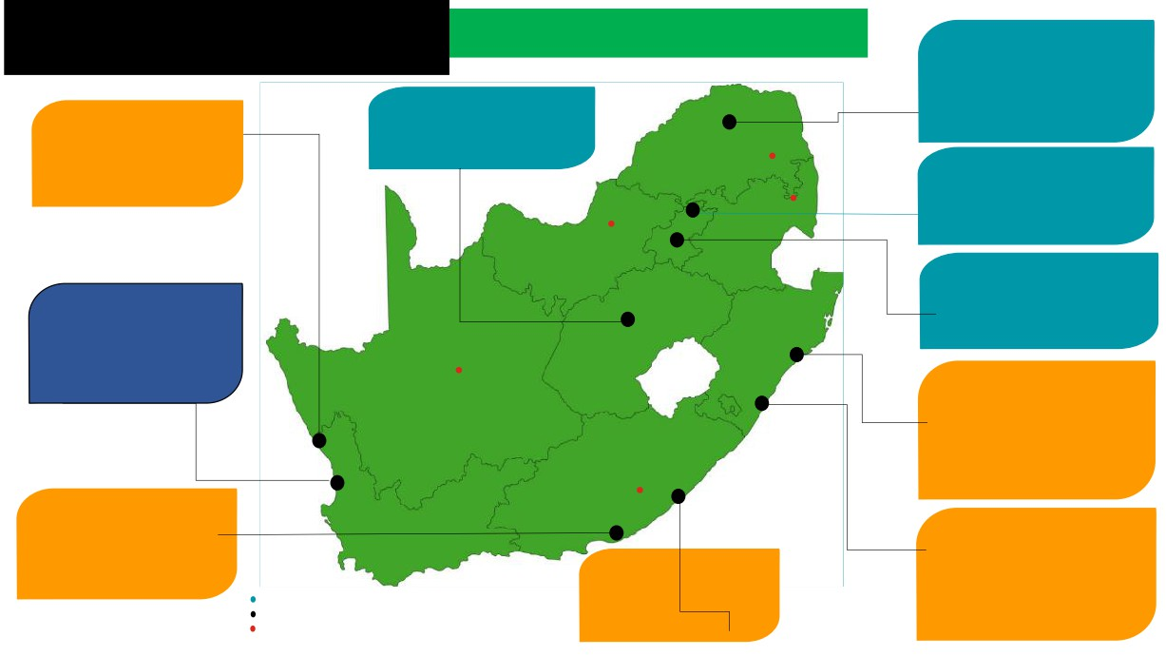
Special Economic Zones
Musina-Makhado (Limpopo)Maluti-a-Phofung (Free State)
ed and Proposed SEZs
• 7 262ha in size
•• •
Agro-processing; mineral
Multi-modal logistics hub
•
beneficiation; and petro
Multi-sector
Maluti-a-Phofung (Free State)
chemicals
• Proximity to main land-based route into SADC
Saldanah (Western Cape)
•1 039ha in size
• 356ha in size
•Multi-modal logistics hub
• Oil and gas, marine repair
•Multi-sector
Tubatse
Tshwane Automotive
engineering and logistics
(Gauteng)
Nkomazi Gauteng Science & Hi-Tech Hub
• 204ha in size
• Automotive suppliers;
Bojanala
• Component manufacturers Tier 1, 2 & 3
OR Tambo (Gauteng)
• 7.5ha in size
Atlantis Greentech (Western Cape)
• Beneficiation of precious metals and minerals, and perishable
• The City of Cape Town has made three large greenfield
food
• Multi-site development
sites available
• Renewable energy and greentech hub
Upington
Richards Bay (KwaZulu-Natal)
• 383ha in size
• Manufacturing, storage of minerals and logistics
• N2 business corridor connecting to Durban port, Maputo in
Mozambique and areas of East Africa
Wild Coast: Mthatha
Coega (Eastern Cape)
• 9 003ha in size
Dube Trade Port (KwaZulu- Natal)
• General manufacturing,
agro-processing, aquaculture, business
East London (Eastern Cape)
• 303ha in size
processing services and auto
Key:
• 462ha in size
• Auto, electronics, fashion garments
Designated but non-operational SEZ Designated and operational SEZ
• General manufacturing, aquaculture, agro-processing
• Facility in Africa with international airport, cargo terminal
Proposed SEZs
and auto
warehousing offices retail hotel and agriculture

Slide 9
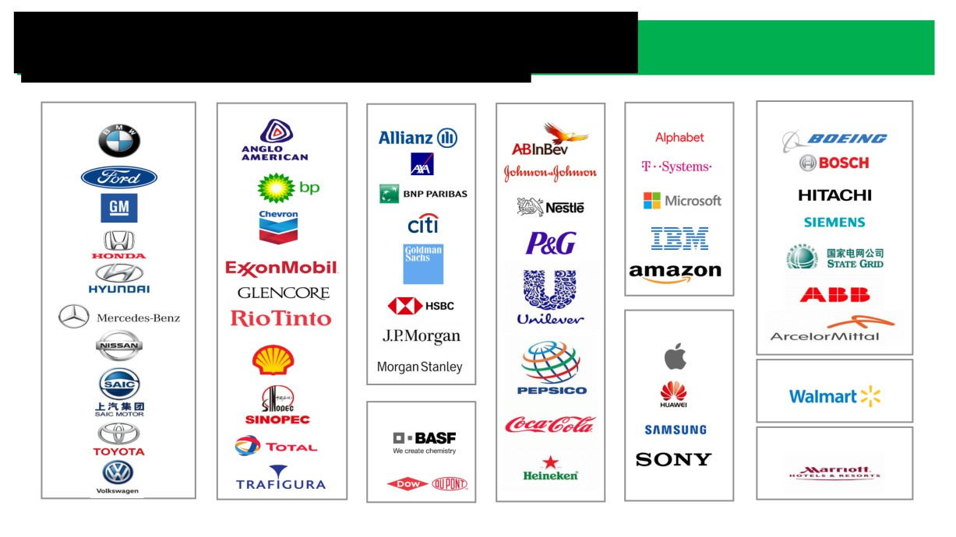
A preferred investment destination in Africa
Sample of Fortune 500 global companies present in South Africa
Automotive
Resources
Financial Services
FMCG
ICT
Technology/Engineering
Electronics
Retail
Chemicals
Hospitality

Slide 10
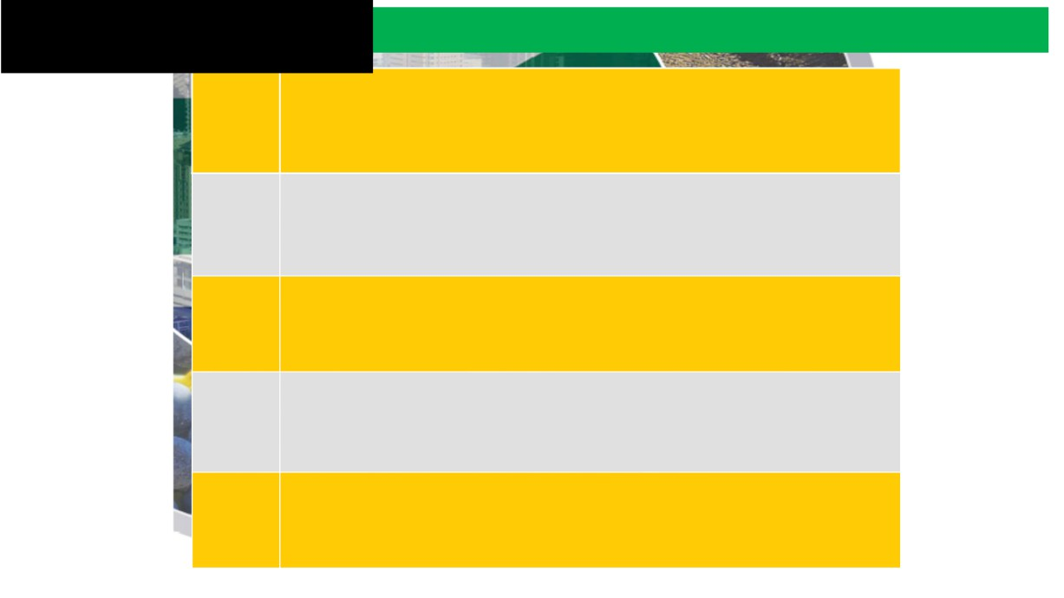
Why South Africa?
VIBRANT EMERGINGMARKET
1
• One of the most sophisticated and promising emerging markets
• Affluent consumer base, growing middle class
• Industrial base to drive long-term returns on investment
MOST DEVELOPED ECONOMY IN AFRICA
2
• Most industrialised and diversified economy on the continent
• Principal manufacturing hub inAfrica
• Leading services destination
LARGEST PRESENCE OF MULTINATIONAL CORPORATIONS IN AFRICA
3
• Location of choice for multinationals in Africa
• Supportive ecosystem as a hub for innovation, technology and fintech
PROGRESSIVE CONSTITUTIONAND INDEPENDENT JUDICIARY
4
• Mature, accessible legal system provides certainty, respect for rule of law
• Sound regulatory framework adhering to international standards
PROVIDES INVESTORS ACCESS TO GLOBALMARKETS
5
• Several trade agreements support export market growth prospects
• Export potential boosted by African Continental FTA

Slide 11
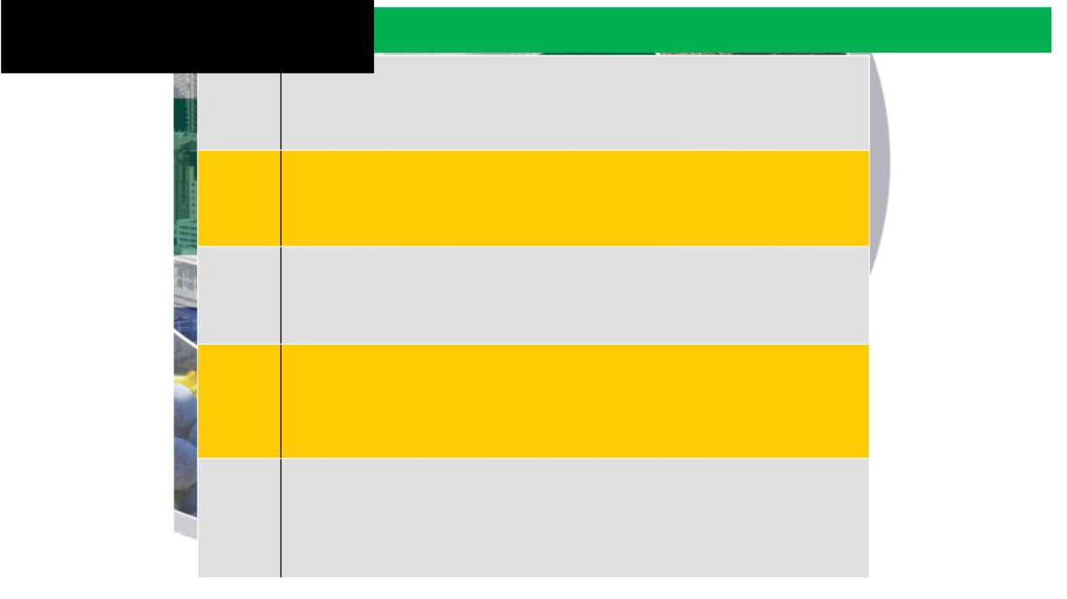
Why South Africa?
T NATURALRESOURCES
6
• Large and diversified mineral resource endowment
• Home to several listed mining companies
• World-renowned underground mining expertise
ADVANCED FINANCIAL SERVICES AND BANKING SECTOR
7
• Sophisticated banking system with major footprint across Africa
• Continent’s financial hub
• Home to Africa’s largest stock exchange by market capitalisation
WORLD-CLASS INFRASTRUCTURE AND LOGISTICS
8
• Highly developed economic infrastructure
• Largest networks of air- and sea-ports, as well as logistics in Africa
• Large infrastructure development programme under way
YOUNG, EAGER LABOUR FORCE
9
• World-class tertiary education system producing a skilled, talented and capable workforce
• Diversified skills set
• Strong skills development support system
EXCELLENT QUALITYOF LIFE
10
• Favourable cost of living
• Generally superb weather all year
• Diversified cultural, cuisine and sports offering
• World-class hospitality sector

Slide 12
Sources: Trade Map - Trade statistics for international business development
Bilateral Trade between South Africa and Greece
Currency: € thousands
Product code | Product label | South Africa's imports from Greece
 |  | Value in 2018 | Value in 2019 | Value in 2020 | Value in 2021 | Value in 2022
TOTAL | All products | 80,658 | 88,331 | 61,286 | 70,222 | 109,582
85 | Electrical machinery and equipment and parts thereof; sound recorders and reproducers, television . . . | 22,860 | 26,239 | 8,418 | 10,656 | 17,412
30 | Pharmaceutical products | 14,325 | 14,595 | 12,963 | 15,686 | 16,867
27 | Mineral fuels, mineral oils and products of their distillation; bituminous substances; mineral . . . | 166 | 84 | 9,624 | 6,765 | 14,783
76 | Aluminium and articles thereof | 7,424 | 5,904 | 4,632 | 5,885 | 7,591
39 | Plastics and articles thereof | 4,668 | 4,113 | 4,084 | 5,896 | 7,508
75 | Nickel and articles thereof | 0 | 0 | 0 | 0 | 5,941
83 | Miscellaneous articles of base metal | 585 | 209 | 170 | 1,246 | 4,402
72 | Iron and steel | 3,756 | 4,261 | 230 | 610 | 3,942
20 | Preparations of vegetables, fruit, nuts or other parts of plants | 1,865 | 2,012 | 1,295 | 1,717 | 3,758
34 | Soap, organic surface-active agents, washing preparations, lubricating preparations, artificial . . . | 267 | 606 | 467 | 1,243 | 3,307

Slide 13
Sources: Trade Map - Trade statistics for international business development
Bilateral Trade between South Africa and Greece
Currency: € thousands
Product code | Product label | South Africa's exports to Greece
 |  | Value in 2018 | Value in 2019 | Value in 2020 | Value in 2021 | Value in 2022
TOTAL | All products | 49,976 | 64,693 | 59,027 | 90,489 | 85,449
76 | Aluminium and articles thereof | 444 | 1,299 | 364 | 21,585 | 26,262
87 | Vehicles other than railway or tramway rolling stock, and parts and accessories thereof | 20,685 | 17,280 | 10,989 | 22,510 | 11,523
23 | Residues and waste from the food industries; prepared animal fodder | 2,351 | 5,150 | 14,417 | 10,205 | 7,730
03 | Fish and crustaceans, molluscs and other aquatic invertebrates | 5,704 | 6,792 | 4,061 | 6,573 | 7,036
39 | Plastics and articles thereof | 1,759 | 7,597 | 5,403 | 5,750 | 6,208
08 | Edible fruit and nuts; peel of citrus fruit or melons | 4,710 | 4,822 | 5,393 | 7,801 | 6,111
20 | Preparations of vegetables, fruit, nuts or other parts of plants | 2,610 | 3,846 | 3,683 | 5,395 | 3,902
78 | Lead and articles thereof | 0 | 0 | 0 | 0 | 1,753
72 | Iron and steel | 706 | 549 | 987 | 2,079 | 1,707
28 | Inorganic chemicals; organic or inorganic compounds of precious metals, of rare-earth metals, . . . | 257 | 378 | 49 | 36 | 1,308

Slide 14
Why South Africa?
Why South Africa?
Agreements between the Republic of South Africa and the Hellenic Republic
Science and Technology Co-operation Agreement
Arts and Culture Co-operation Agreement
Trade and Economic Cooperation Agreement
Sport Agreement
Promotion and Protection of Investment Agreement
Merchant Shipping and Related Maritime Agreement
Bilateral Air Service Agreement
Avoidance of Double Taxation Agreement

Slide 15
www.investsa.gov.za

Slide 16
Sector Fact Sheets

Slide 17
www.doingbusiness.org.za

Slide 18
www.energyoss.gov.za

Slide 19
Thank you
Thank You

Slide 20
Contact details:
Ms Dina Kapoutsis
Trade and Information Assistant
South African Embassy
60, Kifissias Avenue
Marousi 151 25
Athens
Tel: 210-6178044 /210-6178020
E-mail: Kapoutsisd@dirco.gov.za
athens.info@dirco.gov.za

